Slide 1
Portfolio risk measures
October 2024
Charlie Nash
Head of QRA
Alan Cubbon
Head of Research

Slide 2
RISK MEASURES – A RECAP
Volatility
This is the standard deviation of the normal distribution and is a measure of its breadth. The higher the volatility the greater the uncertainty of the final return. According to the theory there is a roughly two-thirds probability that the asset’s return will be within +/-1 standard deviation of the mean.
The normal distribution is of course symmetric. So, volatility is not only a measure of downside risk but also a measure of the possibility of out-performing the mean.
Source: CAIM, October 2024

Slide 3
DOWNSIDE RISK MEASURES
VaR
CVaR
VaR, “Value at Risk”, is a measure of downside risk. It tells you what your minimum loss will be in the worst x% of cases. x is a threshold you choose: typically, 5 or 1 (or both). For a daily VaR with a threshold of 5%, for example, we’re asking “what’s the best I can hope for on the worst day of the month?”
VaR tells you what your minimum loss will be if the worst happens. CVaR, or “Conditional Value at Risk” tells you what you can expect your loss to be if the worst happens. CVaR is the average value of the tail of the distribution to the left of the VaR. It is often regarded as a better measure of risk than VaR.
Source: CAIM, October 2024

Slide 4
RETURN AND RISK GO TOGETHER
Risks are dependent on return estimates
VaR Threshold, % | VaR Threshold, % | 5
 | Asset A | Asset B
Mean | 0 | 2
Std Dev | 1 | 2
VaR | -1.64 | -1.29
CVaR | -2.06 | -2.13
In this example asset B has a tracking error twice that of asset A; but because of its higher forecast mean B has a lower VaR than A. The CVaRs of A and B are almost identical.
Source: CAIM, October 2024

Slide 5
<< MOVES TO EXCEL >>

Slide 6
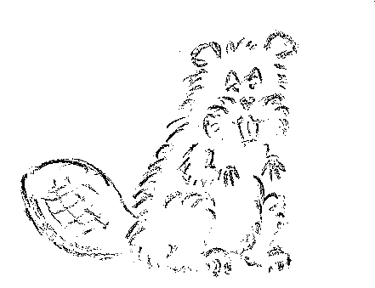
WHAT’s WRONG WITH THE NORMAL DISTRIBUTION?
Historical return distributions often have fat tails
If we look at a histogram of the monthly returns of US Treasuries over the past 20 years, it matches a normal distribution pretty well.
However, for less liquid markets subject to credit risks, we often find that there was a greater likelihood of extreme events than the normal distribution predicts: a phenomenon known as “leptokurtosis”.
This means there is a role for downside risk measures in addition to the more common volatility and tracking error.
US Treasuries
US IG Corporates
US HY Corporates
Source: ICE, CAIM, October 2024

Slide 7
Another WAY TO PICTURE RISKS
We will use scenario scatter charts to illustrate the empirical calculation of risk measures
From the table of asset returns it’s possible to calculate the returns of any portfolio – or benchmark – made up from some combination of those assets.
We could plot such portfolio-benchmark return pairs in an x-y chart, as shown here.
Each blue dot represents one scenario. The scenarios are actually 240 monthly returns of two assets, from the past 20 years.
All scenarios are equally likely. The red y = x line marks where the returns of the portfolio and the benchmark are the same.
Source: ICE, CAIM, October 2024

Slide 8
TRACKING ERROR
Calculating this empirically
In any single scenario the difference between the return of the portfolio and the benchmark is the vertical distance of the scenario from the red line.
Above the red line the portfolio out-performed the benchmark and the difference is positive. Below the line the portfolio under-performed the benchmark, and the difference is negative.
The portfolio’s tracking error is the standard deviation of all these positive and negative differences.
Source: ICE, CAIM, October 2024

Slide 9
Probability of shortfall
A measure of downside risk
We may not be worried about scenarios where the portfolio out-performs the benchmark, but we want to manage the risks of under-performance
“Probability of shortfall” measures the likelihood of under-performing a target return. If the target is the benchmark return, then the probability of shortfall is just the proportion of blue dots that are below the red line.
However, a scenario far below the line counts as much as one just slightly below.
Out-performance
Under-performance/
shortfall
Source: ICE, CAIM, October 2024

Slide 10
Expected shortfall
A more useful downside risk measure
In any single scenario the shortfall is zero if the portfolio out-performed its return target. If the portfolio under-performed the shortfall is the amount of under-performance, as given by the vertical distance of the scenario below the red line.
Expected shortfall is the average of all shortfalls, including the zeroes where the portfolio out-performed.
This is a more commonly used measure of risk than probability of shortfall as it conveys more information on the size of shortfalls.
Source: ICE, CAIM, October 2024

Slide 11
VAR AND cvar
CVaR is akin to expected shortfall relative to a return target of the VaR, given that shortfall occurs
VaR at a threshold of 5%, for example, can be pictured as a line which goes through the 12th worst scenario out of all 240 shown.
CVaR differs from expected shortfall in that it assumes a shortfall happens.
CVaR is represented by the grey line which shows the average relative return of all scenarios where the portfolio under-performs the orange VaR line (the shaded grey area).
VaR
CVaR
Source: ICE, CAIM, October 2024

Slide 12

KEY POINTS
Be mindful of fat tails, but don’t neglect central measures
We have looked at parametric and scenario-based representation of portfolio risks and returns.
Extreme events happen more often than predicted by the normal distribution: so-called “fat tails”.
Downside measures of risk are useful for controlling exposure to such events. But there’s still a role for volatility and tracking error in less extreme times!
Risk and return go together. Adding risky assets to a portfolio, in moderation, can actually reduce risk.
Managers should use a combination of risk measures, pictures and other tools they find useful to build up a more comprehensive understanding of a portfolio’s risks.

Slide 15
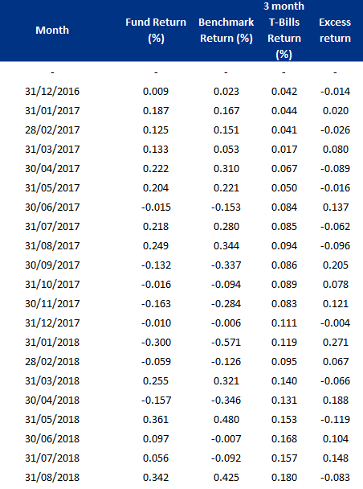
TRACKING ERROR
Ex post method
Tracking Error (TE) calculates the variability (the standard deviation) of a fund’s excess return over its benchmark.
The higher the TE, the greater the variability and therefore risk.
Annual performance (percent)
Calculate the monthly excess returns
Calculate the standard deviation of this data series = STDEV.S(range)
Use 3 years (minimum)
Annualise by multiplying by SQRT(12)
The larger the TE, the greater the risk
$$TE= \sqrt{\frac{\sum{{(a_{i}−\overline{a})}^{2}}}{n−1}}$$
Source: CAIM, October 2024

Slide 16
Information ratio
Risk and Return
IR:
Calculation:
The Information Ratio (IR) measures the outcome and quality of active management
The higher the ratio, the greater the added value per unit of risk
If the fund under performs its benchmark, the ratio is negative
Points to remember:
A high return does not always mean a good return
Better quality means consistently achieving the highest return at the same risk as other funds/managers, or a similar return, but at a lower risk
Risk means volatility
Risk-adjusted performance = Return / Risk (the higher the ratio, the better)
Calculate the annualised returns
calculate the Alpha (Fund return – benchmark return)
Divide the Alpha by the annualised TE
Source: CAIM, October 2024

Slide 17
Time weighting historical data
What about a situation where an asset’s behaviour radically changes, such as due to speculation over a forthcoming bankruptcy or takeover?
In the upper chart an asset’s daily returns have recently become a lot more volatile.
One way of handling such behaviour is to attach greater weight to more recent observations. For example, the lower chart shows a weighting factor applied to each day’s returns (the right-hand y-axis).
The most recent return is given a full weight, the previous day a 97%
weight, the day before 97% of 97%, and so on: an “exponential decay”. The return from 23 days ago is given a weight of just under 50%.
Source: CAIM, October 2024

